Slide 1
3413ICT Network Security
Encryption Modes
Dr V. Muthukkumarasamy
B.Sc.Eng (Hons) (Peradeniya), PhD (Cantab), MIEE, MIEEE

Slide 2
Previous Lecture..
Security concepts:
DAD and CIA Triads
Models for network security
A review to the layered network model
TCP/IP and OSI model
Important protocols & technology: ICMP, SNMP etc.

Slide 3
Today’s Objectives
Review SSH and VPN
Discuss important ciphers which are useful to network security
Study encryption modes for block ciphers, including ECB, CBC, CFB, OFB, CTR

Slide 4
Secure Shell (SSH)
A protocol for secure network communications
designed to be simple & inexpensive
SSH1 provided secure remote logon facility
replace TELNET & other insecure schemes
SSH2 fixes a number of security flaws
Includes authentication and encryption, using variety of methods for ciphers, key exchange and integrity
4
Notes:
There are two versions of Secure Shell available: SSH1 and SSH2. SSH1 and SSH2 are two different protocols and encrypt different parts of the data packet. SSH2 is more secure. To authenticate systems, SSH1 employs user keys, to identify users; host keys, to identify systems; session keys, to encrypt communication in a single session; and server keys, which are temporary keys that protect the session key. SSH2 does not use server keys. SSH2 includes a secure replacement for FTP called Secure File Transfer Protocol (SFTP). Because of the different protocol implementations, SSH1 and SSH2 are not compatible with each other. The OpenSSH project (www.openssh.org),is currently the leading command-line open source implementation of SSH. There are also some other additional secure protocols such as Secure Copy Protocol (SCP), Wget, cURL.
4

Slide 5
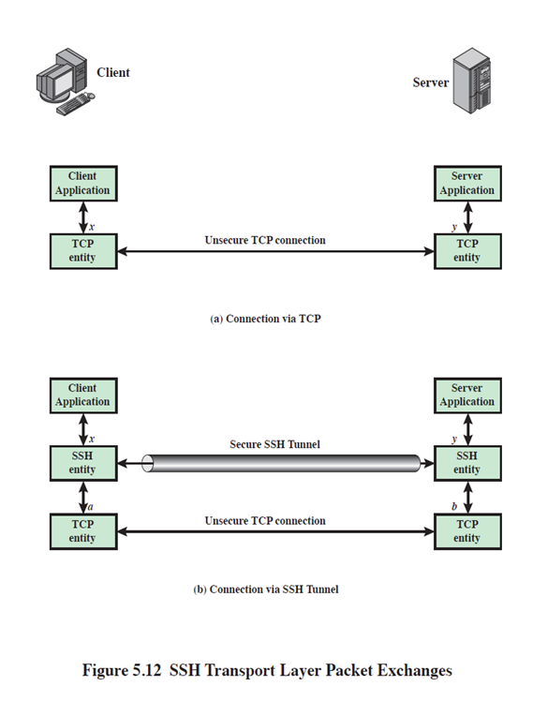
Secure Shell (SSH)
3411ICT Network Security & Administration
5
Notes:
There are two versions of Secure Shell available: SSH1 and SSH2. SSH1 and SSH2 are two different protocols and encrypt different parts of the data packet. SSH2 is more secure. To authenticate systems, SSH1 employs user keys, to identify users; host keys, to identify systems; session keys, to encrypt communication in a single session; and server keys, which are temporary keys that protect the session key. SSH2 does not use server keys. SSH2 includes a secure replacement for FTP called Secure File Transfer Protocol (SFTP). Because of the different protocol implementations, SSH1 and SSH2 are not compatible with each other. The OpenSSH project (www.openssh.org),is currently the leading command-line open source implementation of SSH. There are also some other additional secure protocols such as Secure Copy Protocol (SCP), Wget, cURL.
5

Slide 6
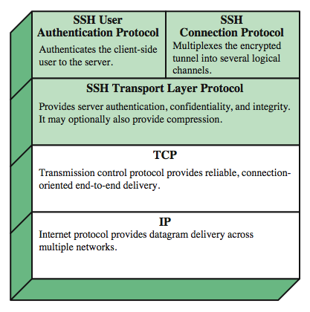
SSH Protocol Stack
6
Notes:
SSH is organized as three protocols that typically run on top of TCP (Stallings Figure 5.8):
• Transport Layer Protocol: Provides server authentication, data confidentiality, and data integrity with forward secrecy (i.e., if a key is compromised during one session, the knowledge does not affect the security of earlier sessions). The transport layer may optionally provide compression.
• User Authentication Protocol: Authenticates the user to the server.
• Connection Protocol: Multiplexes multiple logical communications channels over a single underlying SSH connection.
6

Slide 7
SSH User Authentication Protocol
It authenticates client to server
Three message types:
SSH_MSG_USERAUTH_REQUEST
SSH_MSG_USERAUTH_FAILURE
SSH_MSG_USERAUTH_SUCCESS
Authentication methods used
Username/password based
7
Notes:
The User Authentication Protocol provides the means by which the client is authenticated to the server. Three types of messages are always used in the User Authentication Protocol. Authentication requests from the client have type SSH_MSG_USERAUTH_REQUEST. If the server either (a) rejects the authentication request, or (b) accepts the request but requires one or more additional authentication methods, the server sends a SSH_MSG_USERAUTH_FAILURE message that includes a list of methods that may productively continue the dialog. If the server accepts authentication then it sends a single byte message, SSH_MSG_USERAUTH_SUCCESS.
The server may require one or more of the following authentication methods:
publickey - client sends a message to the server that contains the client's public key, with the message signed by the client's private key
password - client sends a message containing a plaintext password, protected by TLS encryption
hostbased - authentication is performed on the client's host, rather than the client itself
7

Slide 8
SSH Connection Protocol
Assumes secure authentication connection
The secure authentication connection, referred to as a tunnel, is used for multiple logical channels
SSH communications use separate channels
Three stages:
opening a channel
data transfer
closing a channel
8
Notes:
The SSH Connection Protocol runs on top of the SSH Transport Layer Protocol and assumes that a secure authentication connection is in use. That secure authentication connection, referred to as a tunnel is used by the Connection Protocol to multiple a number of logical channels. All types of communication using SSH, such as a terminal session, are supported using separate channels. Either side may open a channel. For each channel, each side associates a unique channel number, which need not be the same on both ends. Channels are flow controlled using a window mechanism. No data may be sent to a channel until a message is received to indicate that window space is available. The life of a channel progresses through three stages: opening a channel, data transfer, and closing a channel. Four channel types are recognized in the SSH Connection Protocol specification:
session - remote execution of a program
x11 - X Window System display traffic
forwarded-tcpip - remote port forwarding
direct-tcpip - local port forwarding
8

Slide 9
SSH Transport Layer Protocol
Server authentication occurs at transport layer, based on server’s host key pair(s)
Server authentication requires clients to know server’s public host keys in advance
Packet exchange:
Establish TCP connection
Then exchange data
algorithm negotiation, key exchange, end of key exchange, etc
Using specified packet format
9
Notes:
Server authentication occurs at the transport layer, based on the server possessing a public/private key pair. The server host key is used during key exchange to authenticate the identity of the host. For this to be possible, the client must have a priori knowledge of the server's public host key.
Next, consider events in the SSH Transport Layer Protocol. First, a client establishes a TCP connection to the server. Once the connection is established, the client and server exchange data, referred to as packets, in the data field of a TCP segment. Each packet has the format shown in Stallings Figure 16.10 and described in the text.
The SSH Transport Layer packet exchange consists of a sequence of steps. The first step, the identification string exchange, begins with the client sending a packet with an identification string. Next comes algorithm negotiation. Each side sends an SSH_MSG_KEXINIT containing lists of supported algorithms, one list for each type of cryptographic algorithm, in the order of preference to the sender. For each category, the algorithm chosen is the first algorithm on the client's list that is also supported by the server. The next step is key exchange. The specification allows for alternative methods of key exchange, but at present only two versions of Diffie-Hellman key exchange are specified. As a result of these steps, the two sides now share a master key K. In addition, the server has been authenticated to the client. The end of key exchange is signaled by the exchange of SSH_MSG_NEWKEYS packets. At this point, both sides may start using the keys generated from K, as discussed subsequently. The final step is service request. The client sends an SSH_MSG_SERVICE_REQUEST packet to request either the User Authentication or the Connection Protocol. Subsequent to this, all data is exchanged as the payload of an SSH Transport Layer packet, protected by encryption and MAC.
9

Slide 10
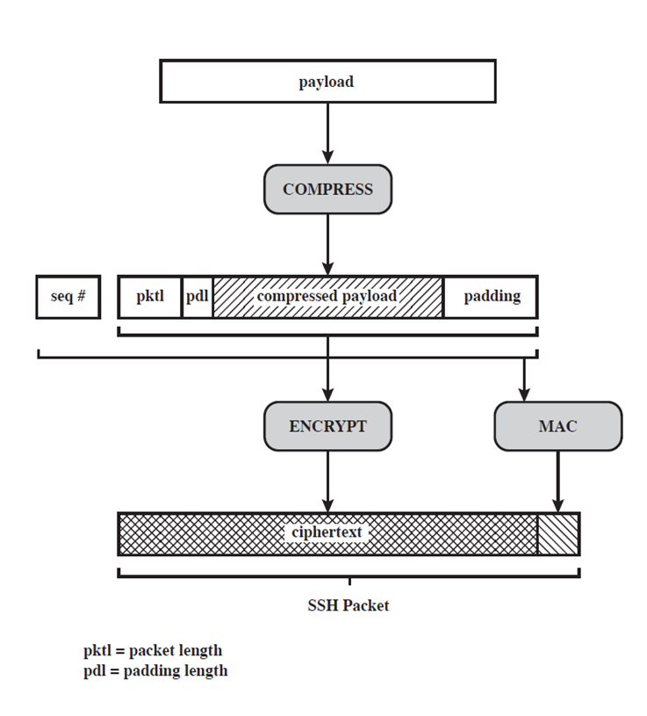
SSH Transport Layer Protocol
SSH packet format:
Packet length
Padding length
Payload
Random padding
MAC
10
Notes:
Server authentication occurs at the transport layer, based on the server possessing a public/private key pair. The server host key is used during key exchange to authenticate the identity of the host. For this to be possible, the client must have a priori knowledge of the server's public host key.
Next, consider events in the SSH Transport Layer Protocol. First, a client establishes a TCP connection to the server. Once the connection is established, the client and server exchange data, referred to as packets, in the data field of a TCP segment. Each packet has the format shown in Stallings Figure 16.10 and described in the text.
The SSH Transport Layer packet exchange consists of a sequence of steps. The first step, the identification string exchange, begins with the client sending a packet with an identification string. Next comes algorithm negotiation. Each side sends an SSH_MSG_KEXINIT containing lists of supported algorithms, one list for each type of cryptographic algorithm, in the order of preference to the sender. For each category, the algorithm chosen is the first algorithm on the client's list that is also supported by the server. The next step is key exchange. The specification allows for alternative methods of key exchange, but at present only two versions of Diffie-Hellman key exchange are specified. As a result of these steps, the two sides now share a master key K. In addition, the server has been authenticated to the client. The end of key exchange is signaled by the exchange of SSH_MSG_NEWKEYS packets. At this point, both sides may start using the keys generated from K, as discussed subsequently. The final step is service request. The client sends an SSH_MSG_SERVICE_REQUEST packet to request either the User Authentication or the Connection Protocol. Subsequent to this, all data is exchanged as the payload of an SSH Transport Layer packet, protected by encryption and MAC.
10

Slide 11
SSH Transport Layer Protocol
Available algorithms
3DES
AES
RC4
CAST-128
HMAC-SHA1
etc.
It is required that these crypto. algorithms (except RC4) are operated in CBC mode
11
Notes:
Server authentication occurs at the transport layer, based on the server possessing a public/private key pair. The server host key is used during key exchange to authenticate the identity of the host. For this to be possible, the client must have a priori knowledge of the server's public host key.
Next, consider events in the SSH Transport Layer Protocol. First, a client establishes a TCP connection to the server. Once the connection is established, the client and server exchange data, referred to as packets, in the data field of a TCP segment. Each packet has the format shown in Stallings Figure 16.10 and described in the text.
The SSH Transport Layer packet exchange consists of a sequence of steps. The first step, the identification string exchange, begins with the client sending a packet with an identification string. Next comes algorithm negotiation. Each side sends an SSH_MSG_KEXINIT containing lists of supported algorithms, one list for each type of cryptographic algorithm, in the order of preference to the sender. For each category, the algorithm chosen is the first algorithm on the client's list that is also supported by the server. The next step is key exchange. The specification allows for alternative methods of key exchange, but at present only two versions of Diffie-Hellman key exchange are specified. As a result of these steps, the two sides now share a master key K. In addition, the server has been authenticated to the client. The end of key exchange is signaled by the exchange of SSH_MSG_NEWKEYS packets. At this point, both sides may start using the keys generated from K, as discussed subsequently. The final step is service request. The client sends an SSH_MSG_SERVICE_REQUEST packet to request either the User Authentication or the Connection Protocol. Subsequent to this, all data is exchanged as the payload of an SSH Transport Layer packet, protected by encryption and MAC.
11

Slide 12
Virtual Private Networking
Virtual private networking (VPN):
A technology that allows private networks to be safely extended over long physical distances by making use of a public network, such as the Internet, as a means of transport
VPN provides guarantees of data confidentiality, integrity, and authentication, despite the use of an untrusted network for transmission
There are two primary types of VPNs: remote access VPN, and site-to-site VPN
12

Slide 13
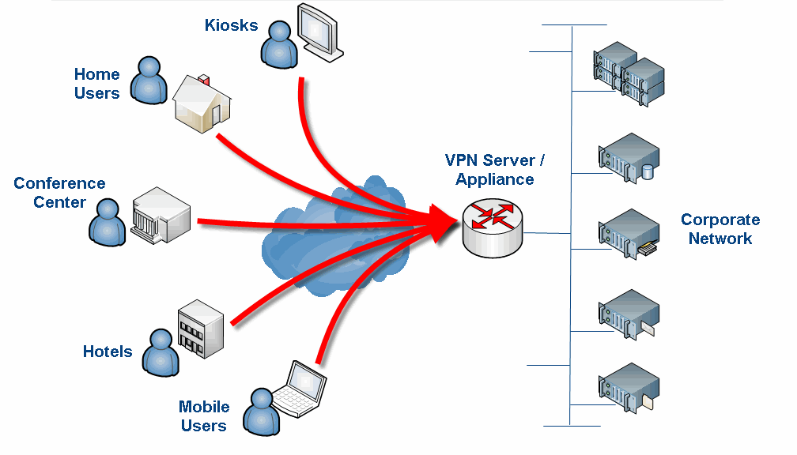
Remote Access VPNs
Remote access VPNs allow authorized clients to access a private network that is referred to as an intranet
An organization can allow employees access to the company network remotely
The organization sets up a VPN endpoint, known as a network access server, or NAS
Clients typically install VPN client software on their machines, which handle negotiating a connection to the NAS and facilitating communications
3411ICT Network Security & Administration
13

Slide 14
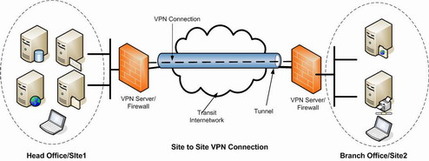
Site-to-Site VPNs
Site-to-site VPN solutions are designed to provide a secure bridge between two or more physically distant networks
Before VPN, organizations had to purchase expensive leased lines to directly connect their intranets with cabling
14

Slide 15
VPN: Security
Firewalls
IPSec
Authentication
User/System and Data
AAA Servers
(Authentication, Authorization, and Accounting)
Encryption
15
Notes:
15

Slide 16
More Techniques or Better Operations?
We studied a lot of security techniques and protocols:
DES / AES / RSA, etc
IPsec
Pretty Good Privacy (PGP)
Secure Multipurpose Internet Mail extensions (S/MIME)
SSL
SSH
Secure Electronic Transfer (SET)
And we will study even more
Should we try to invent more techniques, or explore the best operations of using the existing ones?
16
Notes:
16

Slide 17
Advanced Cryptography
Symmetric encryption schemes
DES, 3DES, AES, RC4 (RC5, RC6), LFSR-based ciphers
Asymmetric encryption schemes
RSA, ECC, etc
Block ciphers
Message is divided into blocks, e.g., 64 or 128 bits, then each block is encrypted using the algorithm and key
Stream ciphers
Successive message bits are encrypted with successive bits of the key
LFSR-based ciphers (e.g., A5, E0), software-oriented ciphers (e.g., RC4)
17
Notes:
Griffith University, School of Information Technology
2010/2
7501ICT Information Security
17
Now look at a simple form of encryption based on two concepts: the block cipher and the stream cipher.
Stream ciphers are based on a PRNG. The strength of the cipher depends on just how good the PRNG is. Good algorithms employ a lot of state and are highly secure. Stream ciphers must never re-use the same key and many mistakes occur because of this (Word/Excel encryption, WEP and so on).
With the block cipher method, the message is divided into blocks, i.e., 64 or 128 bit blocks, and then each block is transformed using the algorithm and key.

Slide 18
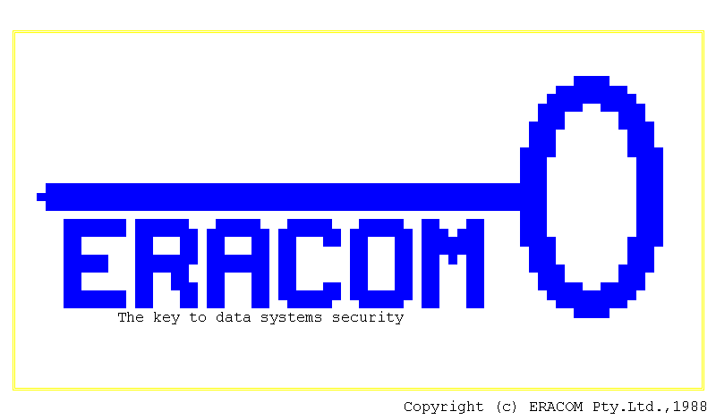


Do Operation Modes Make Sense ?
18
Notes:
Griffith University, School of Information Technology
2010/2
7501ICT Information Security
18

Slide 19
Modes of Operation
Block ciphers encrypt fixed size blocks:
eg. DES encrypts 64-bit blocks, with 56-bit key;
Need way to use in practise, given usually have arbitrary amount of information to encrypt;
Four were defined for DES in ANSI standard ANSI X3.106-1983 Modes of Use;
Subsequently now have 5 for DES and AES:
block and stream modes.
Notes:
DES (or any block cipher) forms a basic building block, which en/decrypts a fixed sized block of data. However to use these in practise, we usually need to handle arbitrary amounts of data, which may be available in advance (in which case a block mode is appropriate), and may only be available a bit/byte at a time (in which case a stream mode is used).

Slide 20
Encryption Modes
In cryptography, mode of operation is the procedure of enabling the repeated and secure use of a block cipher under a single key
A variable-length message is first partitioned into separate blocks (the last block must also be extended to match the cipher's block length using a suitable padding)
An operation mode gives the process of encrypting each of the blocks
May need to use an additional input value, called an initialization vector (IV)
Not only be associated with symmetric encryption, they may also be applied to public-key encryption (such as RSA)
Types: ECB, CBC, CFB, OFB, CTR
20
Notes:
Griffith University, School of Information Technology
2010/2
7501ICT Information Security
20
ECB is the simplest of the modes, where each block is en/decrypted independently of all the other blocks, and is used when only a single block of info needs to be sent (eg. a session key encrypted using a master key).

Slide 21
Electronic Codebook Book (ECB)
Message is broken into independent blocks which are encrypted;
Each block is a value which is substituted, like a codebook, hence name;
Each block is encoded independently of the other blocks
C_{i} = DES_{K} (P_{i})
Uses: secure transmission of single values.
Notes:
ECB is the simplest of the modes, where each block is en/decrypted independently of all the other blocks, and is used when only a single block of info needs to be sent (eg. a session key encrypted using a master key).

Slide 22
Electronic Code Book (ECB)
Plaintext
P_{i}
P_{i+1}
P_{i+2}
Key K
Encrypt
Encrypt
Encrypt
Ciphertext
C_{i}
C_{i+1}
C_{i+2}
Key K
Decrypt
Decrypt
Decrypt
Plaintext
P_{i}
P_{i+1}
P_{i+2}

Slide 23
Advantages and Limitations of ECB
Repetitions in message may show in ciphertext:
If aligned with message block,
Particularly with data such graphics,
Or with messages that change very little, which become a code-book analysis problem;
Weakness due to encrypted message blocks being independent;
Main use is sending a few blocks of data.
Notes:
ECB is not appropriate for any quantity of data, since repetitions can be seen, esp. with graphics, and because the blocks can be shuffled/inserted without affecting the en/decryption of each block.

Slide 24
Plain text logo

Slide 25
Encrypted (ECB) using key 0123456789ABCDEF
Notes:
In ECB mode Patterns in the plaintext may give rise to patterns in the ciphertext.

Slide 26
Cipher Block Chaining (CBC)
Message is broken into blocks;
These are linked together in the encryption operation;
Each previous cipher block is XORed with current plaintext block;
Use Initial Vector (IV) to start process
C_{i} = DES_{K}(P_{i} XOR C_{i-1})
C₋₁ = IV
Uses: bulk data encryption, authentication.
Notes:
To overcome the problems of repetitions and order independence in ECB, want some way of making the ciphertext dependent on all blocks before it. This is what CBC gives us, by combining the previous ciphertext block with the current message block before encrypting. To start the process, use an Initial Value (IV), which is usually well known (often all 0's), or otherwise is sent, ECB encrypted, just before starting CBC use. CBC mode is applicable whenever large amounts of data need to be sent securely, provided that its available in advance (eg email, FTP, web etc)

Slide 27
Cipher Block Chaining (CBC)
P₀
P_{i}
P_{i+1}
IV
+
+
+
Key K
Encrypt
Encrypt
Encrypt
C₀
C_{i}
C_{i+1}
Notes:
This is a more manageable diagram showing just the encryption part of the process for CBC.
Other cipher modes are shown in the same way – the decryption is the inverse process as for CBC and you should consider drawing the decryption diagrams as an exercise.

Slide 28
Cipher Block Chaining (CBC)
P₀
P_{i}
P_{i+1}
+
+
+
Key K
Encrypt
Encrypt
Encrypt
IV
C₀
C_{i}
C_{i+1}
Key K
Decrypt
Decrypt
Decrypt
+
+
+
P₀
P_{i}
P_{i+1}
Notes:
This slide is a pictorial representation of the whole CBC process across several blocks. Note that the same key is always used to encrypt and decrypt and the IV is required at the start.

Slide 29
Encrypted (CBC) using key 0123456789ABCDEF and IFV D8BB7513FBA9362C

Slide 30
Advantages and Limitations of CBC
Each ciphertext block depends on all message blocks;
A change in the message affects all ciphertext blocks after the change as well as the original block;
Need Initial Value (IV) known to sender & receiver
However if IV is sent in the clear, an attacker can change bits of the first block, and change IV to compensate,
Either IV must be a fixed value (as in EFTPOS) or it must be sent encrypted in ECB mode before rest of message;
At end of message, handle possible last short block;
Padding with known non-data value (eg nulls), or
Pad last block with count of pad size
eg. [ b1 b2 b3 0 0 0 0 5] <- 3 data bytes, then 5 bytes pad+count.
Notes:
CBC is the generally used block mode. The chaining provides an avalanche effect, which means the encrypted message
cannot be changed or rearranged without totally destroying the subsequent data.
One issue is how to handle the last block, which may well not be complete. In general have to pad this block (typically with 0's), and then must recognise padding at other end - may be obvious (eg in text the 0 value should usually not occur), or otherwise must explicitly have the last byte as a count of how much padding was used (including the count). Note that if this is done, if the last block IS an even multiple of 8 bytes, will have to add an extra block, all padding so as to have a count in the last byte.

Slide 31
Output FeedBack (OFB)
Message is treated as a stream of bits
Output of cipher is added (XORed) to message
Output is then feed back (hence name)
Feedback is independent of message
Can be computed in advance
C_{i} = P_{i} XOR O_{i}
O_{i} = DES_{K}(O_{i-1})
O₋₁ = IV
Uses: stream encryption over noisy channels
Notes:
The alternative to CFB is OFB. Here the generation of the "random" bits is independent of the message being encrypted. The advantage is that firstly, they can be computed in advance, good for bursty traffic, and secondly, any bit error only affects a single bit. Thus this is good for noisy links (eg satellite TV transmissions etc).

Slide 32
Output Feedback - OFB
IV
Encrypt
Encrypt
Encrypt
Plaintext
P₀
+
P_{i}
+
P_{i+1}
+
Ciphertext
C₀
C_{i}
C_{i+1}

Slide 33
Advantages and Limitations of OFB
Used when error feedback a problem or where need to do encryptions before message is available;
Superficially similar to CFB but feedback is from the output of cipher and is independent of message;
A variation of a Vernam cipher
hence must never reuse the same sequence (key+IV);
Sender and receiver must remain in sync, and some recovery method is needed to ensure this occurs;
Originally specified with m-bit feedback in the standards, but subsequent research has shown that only OFB-64 should ever be used.
Notes:
Because the "random" bits are independent of the message, they must never ever be used more than once (otherwise the 2 ciphertexts can be combined, cancelling these bits, and leaving a "book" cipher to solve). Also, as noted, should only ever use a full block feedback ie OFB-64 mode.

Slide 34
Cipher FeedBack (CFB)
Message is treated as a stream of bits/bytes XORed to the output of the block cipher
Result is feed back for next stage (hence name)
Standard allows any number of bit (1,8 or 64 or whatever) to be feed back
denoted CFB-1, CFB-8, CFB-64 etc;
Is most efficient to use all 64 bits (CFB-64)
C_{i} = P_{i} XOR DES_{K}(C_{i-1})
C₋₁ = IV
Uses: stream data encryption, authentication
Notes:
If the data is only available a bit/byte at a time (eg. terminal session, sensor value etc), then must use some other approach to encrypting it, so as not to delay the info. Idea here is to use the block cipher essentially as a pseudo-random number generator (see stream cipher lecture later) and to combine these "random" bits with the message. Note as mentioned before, XOR is an easily inverted operator (just XOR with same thing again to undo). Again start with an IV to get things going, then use the ciphertext as the next input. As originally defined, idea was to "consume" as much of the "random" output as needed for each message unit (bit/byte) before "bumping" bits out of the buffer and re-encrypting. This is wasteful though, and slows the encryption down as more encryptions are needed. An alternate way to think of it is to generate a block of "random" bits, consume them as message bits/bytes arrive, and when they're used up, only then feed a full block of ciphertext back. This is CFB-64 mode, the most efficient. This is the usual choice for quantities of stream oriented data, and for authentication use.

Slide 35
Cipher Feedback - CFB
IV
Encrypt
Encrypt
Encrypt
Plaintext
P₀
+
P_{i}
+
P_{i+1}
+
Ciphertext
C₀
C_{i}
C_{i+1}

Slide 36
Advantages and Limitations of CFB
Appropriate when data arrives in bits/bytes;
Most common stream mode;
Limitation is need to stall while do block encryption after every n-bits;
Note that the block cipher is used in encryption mode at both ends;
Errors propogate for several blocks after the error.
Notes:
CFB is the usual stream mode. As long as can keep up with the input, doing encryptions every 8 bytes. A possible problem is that if its used over a "noisy" link, then any corrupted bit will destroy values in the current and next blocks (since the current block feeds as input to create the random bits for the next). So either must use over a reliable network transport layer (pretty usual) or use OFB.

Slide 37
Counter (CTR)
“New” mode, though proposed early on;
Similar to OFB but encrypts counter value rather than any feedback value;
Must have a different key & counter value for every plaintext block (never reused)
C_{i} = P_{i} XOR O_{i} O_{i} = DES_{K} (I++)
Uses: high-speed network encryptions.

Slide 38
Counter Mode - CTR
Counter_{i}++
Counter_{i}++
Key K
Encrypt
Key K
Encrypt
Plaintext
P_{i}
Ciphertext
C_{i}
Ciphertext
C_{i}
Plaintext
P_{i}
Encryption
Decryption

Slide 39
Advantages and Limitations of CTR
Efficiency:
can do parallel encryptions in advance of need,
good for bursty high speed links;
Random access to encrypted data blocks;
Provable security (good as other modes);
But must ensure never reuse key/counter values, otherwise could break (cf OFB)

Slide 40
Summary
Have considered:
SSH and VPN
Important ciphers which are useful to network security
Encryption modes for block ciphers, including ECB, CBC, CFB, OFB, CTR

Slide 41
Next Lecture
Advanced Stream Ciphers
41

Slide 42

Questions?
42

